Slide 1

DS 489 Final Project Presentation
Ashishkumar Pemmaraju
WIU ID: 923-19-4632

Slide 2

DATA DESCRIPTION
The data used in the Feature Engineering code is wine bottle data.
It includes variables like Alcohol , Malic Acid, Ash, Alcalinity of Ash, Magnesium, Total Phenols, Flavanoids, Non-flavonoid, Phenols, Proanthocyanins, Color, Intensity, Hue, OD280/OD315 of Diluted Wines, Proline and Number of Bottles.
The count variable used in the data is Number of Bottles.
The dataset has a total of 178 values.
Basically, the data indicates the content of chemicals in the wine type and the number of bottles of each type of wine.
We import different packages like pandas, numpy, matplotlib to easily perform feature preprocessing like handling missing data, removing low variance values, standardizing and performing cluster analysis and count variable regression.

Slide 3
FEATURE PREPROCESSING
Feature preprocessing is the process of transforming raw data into a format that is suitable for machine learning algorithms by performing various operations such as scaling, normalization, encoding categorical variables, handling missing values, and feature engineering.
The wine data used for the study has 178 values and to implement feature preprocessing, dropping the missing values in the dataset is performed using data.dropna().
The output was null because there were no missing values in the dataset.
Standardization ensures all features are on the same scale, making comparisons fair, improving algorithm performance, aiding convergence, enhancing interpretability, and facilitating regularization.
But, for a small scale dataset like the wine data used in this case, standardization of the data is not mandatory.

Slide 4
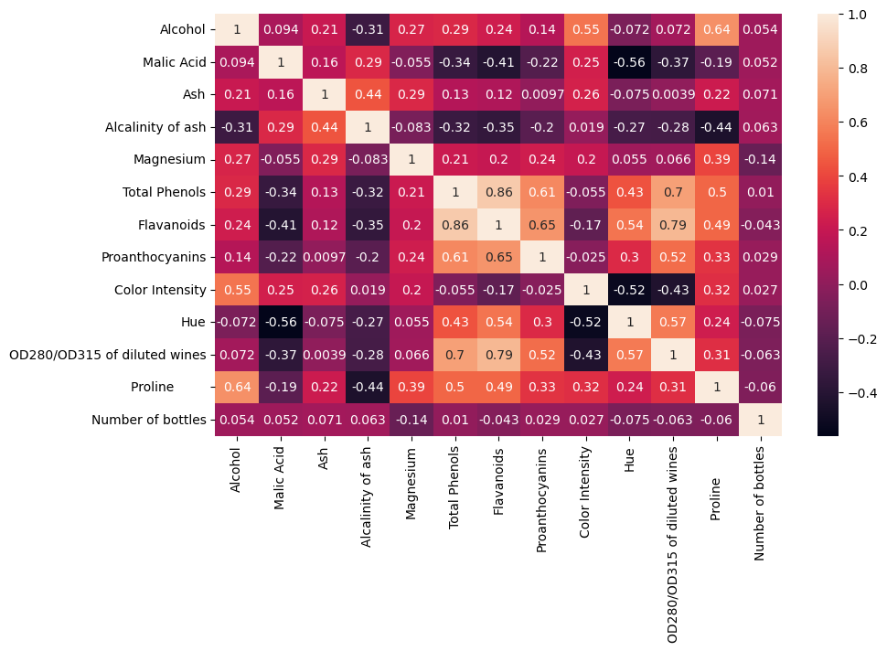
Feature Selection
Feature selection is a critical step in the machine learning pipeline, helping to improve model performance, reduce overfitting, and enhance interpretability by focusing on the most relevant features.
Common techniques include variance thresholding, correlation analysis, and statistical tests.
Variance Thresholding is performed and ‘Non-flavonoid Phenols’ column is removed due to low variance. The threshold is set to 0.05 and apparently the variance of the Non Flavonoid Phenols is less than 0.05.
Feature selection is performed to avoid unnecessary values in the data which might affect the overall output of the analysis performed.
Another procedure correlation analysis is performed to select significant features.
After analysis, it is found that none of the variables exhibit high correlation, hence none of the columns are dropped.

Slide 5
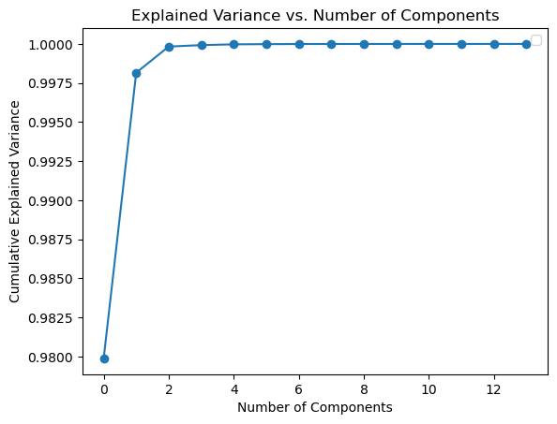
PRINCIPAL COMPONENT ANALYSIS
Principal Component Analysis (PCA) is a powerful technique used in data analysis, particularly for reducing the dimensionality of datasets while preserving crucial information. It does this by transforming the original variables into a set of new, uncorrelated variables called principal components.
We create a elbow plot by taking a random number of components(1 to 10) and Cumulative Explained Variance for the wine data. As the Elbow plot is created, we can see that after 4 components the trend becomes linear which leads us to consider the number of PCA components as 4.
We convert the wine dataset into a data frame and perform PCA using
PCA components as 4 .
The output clearly shows that the % Explained variance for the first
component is 97.878, 1.828 for second component. 0.1672 for third
component and 0.0093 for the fourth component. Which means that
the combined value of the four components provides 99.99% of the variance
in the features.

Slide 6
Is PCA necessary?
The dataset in consideration is a comparatively smaller dataset with 14 columns and 178 observations.
Generally PCA is performed on datasets with high dimensionality, and as the dataset in consideration
Has smaller dimensionality, PCA might not be necessary.
PCA helps address multicollinearity where there are many features with high correlation. But looking at the Correlation matrix of the dataset, we can find that none of the features are highly correlated . Hence, PCA might not be necessary.

Slide 7
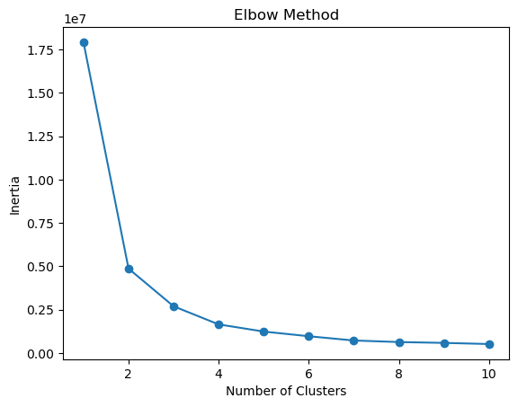
CLUSTERING
> Cluster analysis, also known as clustering, is a method used in unsupervised machine learning to group a set of data
points into clusters or groups based on their similarities. The goal of cluster analysis is to partition the data into
subsets, or clusters, such that data points within the same cluster are more similar to each other than they are to
data points in other cluster.
> To find the number of optimal clusters, we plot the data using matplotlib and k-means clustering to generate an
elbow plot. The elbow point in the plot is the point where the trend becomes linear and the change is not significant.
The elbow point in the plot is found at 4 clusters and hence the optimal number of clusters is considered as 4.
> Later on we perform three types of clustering models:
- K- Means Clustering
- Agglomerative Clustering
- Gaussian Model Clustering

Slide 8
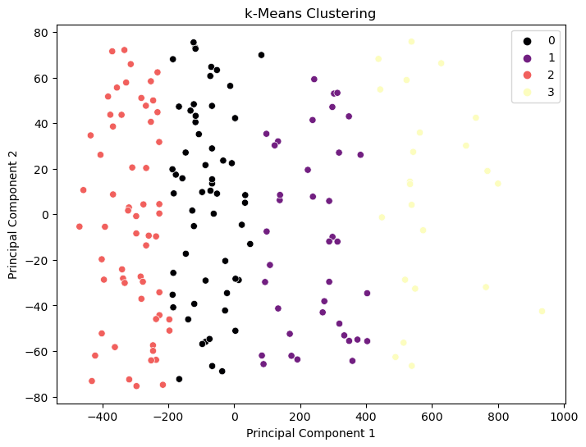
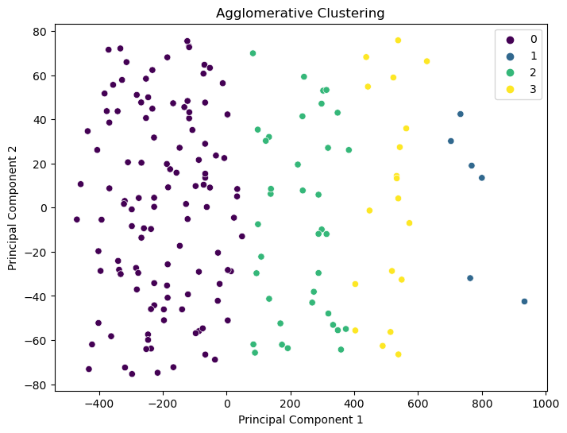
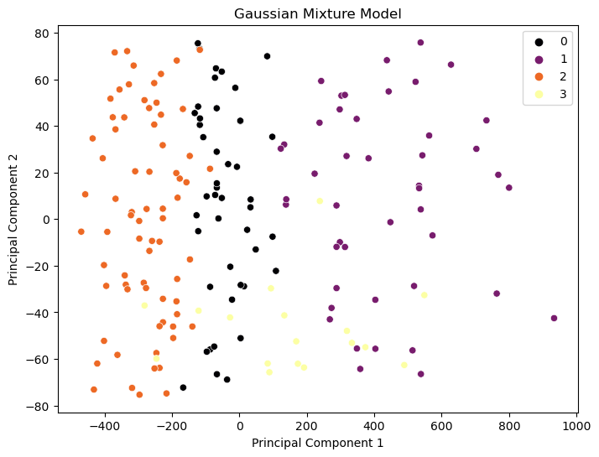
Clustering Outputs
In Gaussian mixture model, we
Can observe that there is
Significant overlapping between Clusters 3,4 indicating lower Efficiency of the Gaussian Mixture Model
Agglomerative clustering is the optimal
Clustering model in my opinion as there
Is visibly no overlapping of clusters and
Clusters are formed proportionally to the
Cumulative explained variance of the
Components.
In K means clustering , we can
Observe that 4 separate clusters
Are clearly visible without any
Significant overlapping.

Slide 9
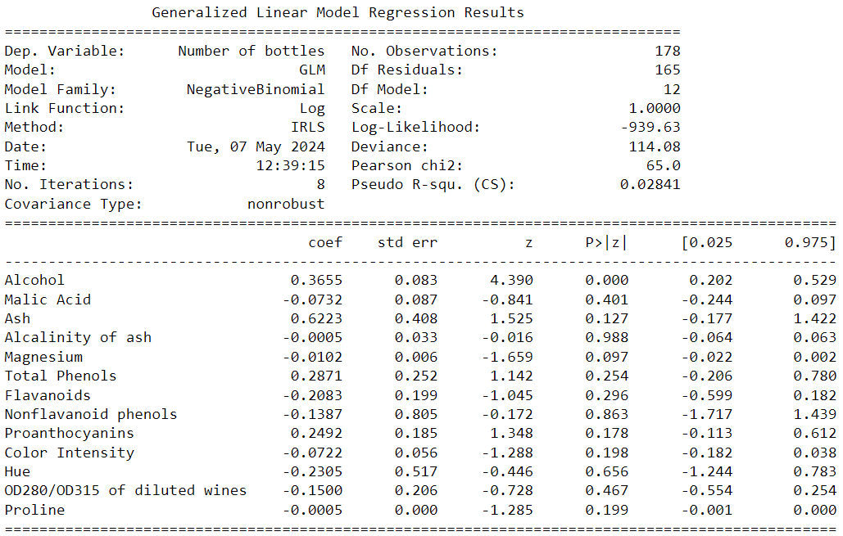
Negative Binomial Regression Model
We use Negative Binomial Regression because The mean of the count variable
‘ Number of bottles’ is lower than the variance of the count variable.
Mean: 72.7022
Standard Deviation: 43.0621
Variance: 1854.344

Slide 10
CONCLUSIONS
As the data has low dimensionality, Principal Component Analysis can be avoided.
The dataset has no missing values and no highly correlated variables due to which, the issue of multicollinearity is avoided.
The interpretability of the variables in the data is very high which helps easily to understand the relevance and effect of the variables on count data.
We understand from the Negative Binomial Regression model that Alcohol content is statistically significant compared to remaining variables clearly portraying that Alcohol content has a significant effect on Number of bottles.
In practical scenarios, the data may have several issues like high dimensionality, skewness, multicollinearity, etc.

Slide 11
THANK YOU

